Slide 1
Flakers
Siddhartha Lavu, Bharath Venkateswaran,
Pranay Boppana, Aditya Srinivasan
Notes:
Introduce team here

Slide 2
How do we improve Productivity?
Time management Remove distractions
Accountability Motivation Clear Goals
Notes:
Problem we identified - lack of accountability towards your goals
Tell our story - going to gym, studying

Slide 3
Solution
Clear Goals
Motivation
Accountability
This is where Flake comes in
Notes:
I’d like to share a brief story
Earlier this semester, Pranay and I created a goal of going to the gym everyday
We kept each other motivated
We kept each other accountable
The key was having someone else, and we decided to take this idea and expand on it. Imagine you are in Dallas and your friend is in Boston. This is where flake comes. We give friends the ability, regardless of their location, to work on achieving goals together.

Slide 4
Flake
Not Just Another Photo Share App

Slide 5
Flake
Product features
Commit to a goal with your friends
Ability to add unlimited number of friends to a goal
Motivate each other every day by posting a picture of the goal
Users will also be notified you when a friend posts their goal
This will motivate the user to be accountable and work towards the goal as well
App will also try to notify and motivate you to accomplish your goal
Goal streaks
If the user posts a goal picture for a consecutive number of days they will receive “achievements or badges”.
Also track private goals
Private feed to track users individual goals
Pictures will come with a timestamp and geotag
Notes:
Youre gonna be able to commit to a goal with your friends
Your gonna stay motivated whenever your friends post in the goal
You will also see when and where your friends have posted
Your also gonna be able to see how long your friends are sticking to their goals
You will also be able to add private goals to keep yourself accountable

Slide 6
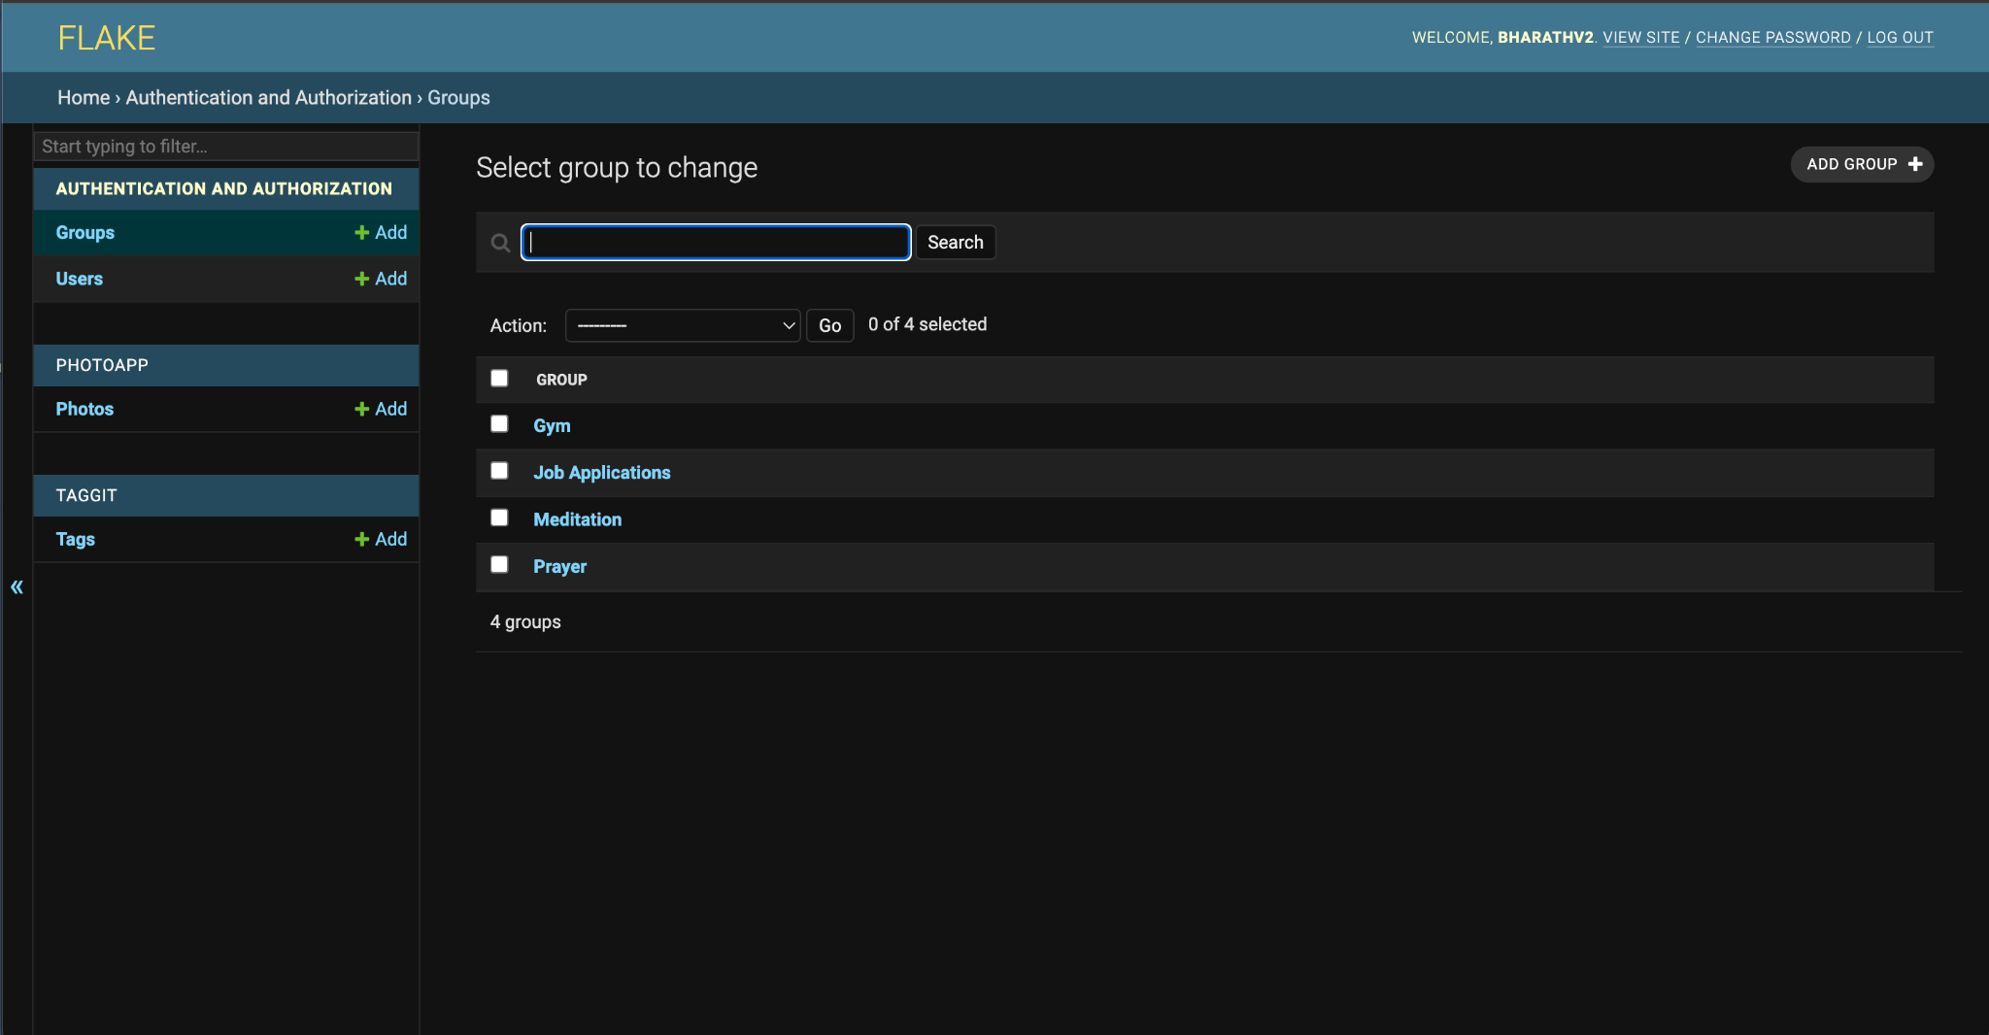
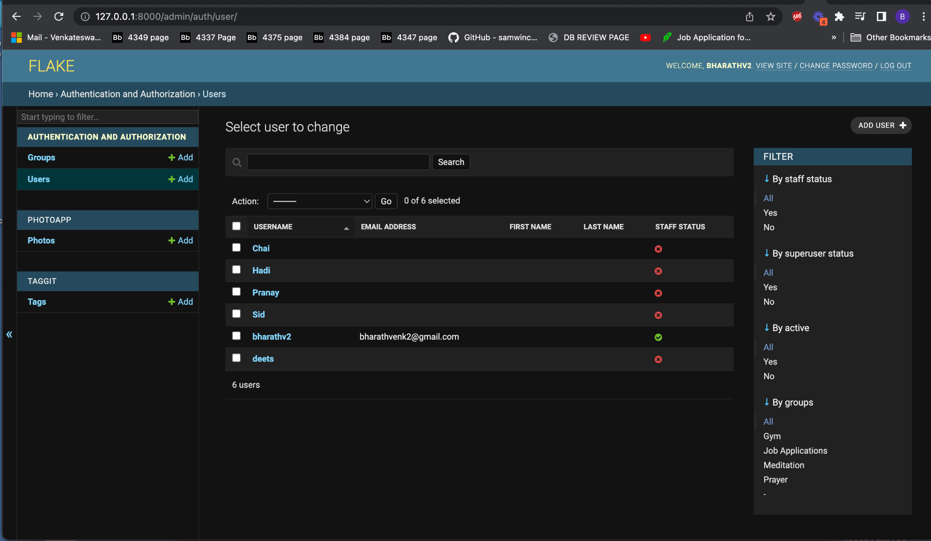
Prototype

Slide 7
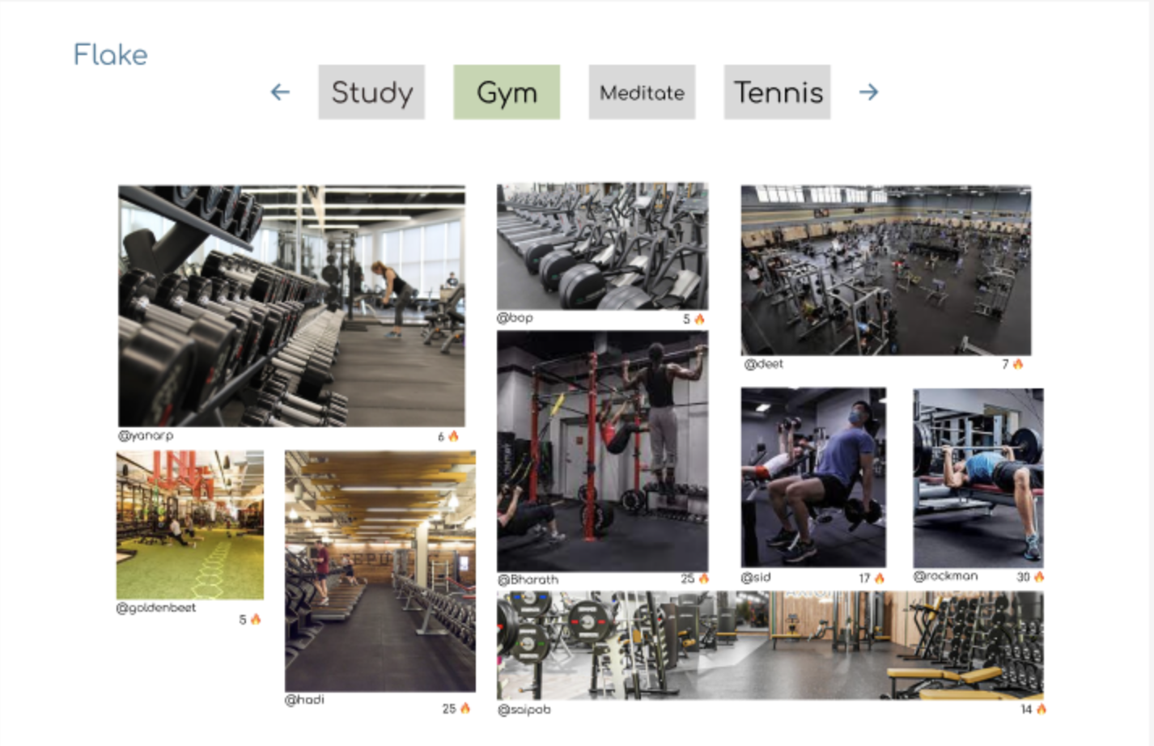
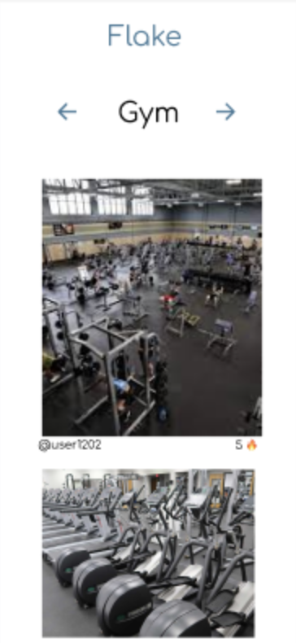
Prototype

Slide 8
Looking ahead
Poke friends to motivate them
Connect with others that have similar goals
Curated timelapse to show goal progression
Further goal customization - length, duration, etc.

Slide 9
Questions?

